Slide 1
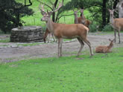
prediction of animal classification in a zoo
Importance of using Technology to correctly classify Animals in a Zoo/Game Park and ensure correct planning, controls and maintenance of animals for economic and environmental sustainability in the Wildlife Ecosystem.
George Abuya
#073171

Slide 2
motivation
Use of Technology i.e. Machine Learning for correct analysis and prediction of item classification in a business environment.
For example, possible mix-up of categories of animals that have closely related features like reptiles/amphibians or Fish/ Invertebrate.
Solution to current manual process of classifying animals in Zoos & Game Parks that can result in wrong decisions, when planning populations of Game Parks in Kenya.
Can also Machine Learning to predict and assist in planning & control of animal populations and types in a Zoo, that can also predict suitability of new Zoo locations, based on known habitat conditions.
This goes beyond using Technology just for recording and reporting of Zoo populations & types.

Slide 3
Dataset
Attribute Information:
1. animal name: Unique for each instance 2. hair: Boolean 3. feathers: Boolean 4. eggs: Boolean 5. milk: Boolean 6. airborne: Boolean 7. aquatic: Boolean 8. predator: Boolean 9. toothed: Boolean 10. backbone: Boolean 11. breathes: Boolean 12. venomous: Boolean 13. fins: Boolean 14. legs: Numeric (set of values: {0,2,4,5,6,8}) 15. tail: Boolean 16. domestic: Boolean 17. catsize: Boolean 18. type: Numeric (integer values in range [1,7])
Zoo Data Set
Dataset consists of
101 animals from a zoo.
7 Class Types: Mammal, Bird, Reptile, Fish, Amphibian, Bug and Invertebrate.
There are 16 variables with various traits to describe the animals.
Data Set Characteristics: Multivariate
Attribute Characteristics: Categorical, Integer
Number of Instances: 101
Area: Life (Wildlife)

Slide 4
DATASET ….Sample….
animal_name | Class_Type | hair | feathers | eggs | milk | airborne | aquatic | predator | toothed | backbone | breathes | venomous | fins | legs | tail | domestic | catsize | class_code
frog | Amphibian | 0 | 0 | 1 | 0 | 0 | 1 | 1 | 1 | 1 | 1 | 0 | 0 | 4 | 0 | 0 | 0 | 5
frog_venomous | Amphibian | 0 | 0 | 1 | 0 | 0 | 1 | 1 | 1 | 1 | 1 | 1 | 0 | 4 | 0 | 0 | 0 | 5
newt | Amphibian | 0 | 0 | 1 | 0 | 0 | 1 | 1 | 1 | 1 | 1 | 0 | 0 | 4 | 1 | 0 | 0 | 5
toad | Amphibian | 0 | 0 | 1 | 0 | 0 | 1 | 0 | 1 | 1 | 1 | 0 | 0 | 4 | 0 | 0 | 0 | 5
chicken | Bird | 0 | 1 | 1 | 0 | 1 | 0 | 0 | 0 | 1 | 1 | 0 | 0 | 2 | 1 | 1 | 0 | 2
crow | Bird | 0 | 1 | 1 | 0 | 1 | 0 | 1 | 0 | 1 | 1 | 0 | 0 | 2 | 1 | 0 | 0 | 2
dove | Bird | 0 | 1 | 1 | 0 | 1 | 0 | 0 | 0 | 1 | 1 | 0 | 0 | 2 | 1 | 1 | 0 | 2
duck | Bird | 0 | 1 | 1 | 0 | 1 | 1 | 0 | 0 | 1 | 1 | 0 | 0 | 2 | 1 | 0 | 0 | 2
flamingo | Bird | 0 | 1 | 1 | 0 | 1 | 0 | 0 | 0 | 1 | 1 | 0 | 0 | 2 | 1 | 0 | 1 | 2
gull | Bird | 0 | 1 | 1 | 0 | 1 | 1 | 1 | 0 | 1 | 1 | 0 | 0 | 2 | 1 | 0 | 0 | 2
hawk | Bird | 0 | 1 | 1 | 0 | 1 | 0 | 1 | 0 | 1 | 1 | 0 | 0 | 2 | 1 | 0 | 0 | 2
kiwi | Bird | 0 | 1 | 1 | 0 | 0 | 0 | 1 | 0 | 1 | 1 | 0 | 0 | 2 | 1 | 0 | 0 | 2
lark | Bird | 0 | 1 | 1 | 0 | 1 | 0 | 0 | 0 | 1 | 1 | 0 | 0 | 2 | 1 | 0 | 0 | 2
ostrich | Bird | 0 | 1 | 1 | 0 | 0 | 0 | 0 | 0 | 1 | 1 | 0 | 0 | 2 | 1 | 0 | 1 | 2
parakeet | Bird | 0 | 1 | 1 | 0 | 1 | 0 | 0 | 0 | 1 | 1 | 0 | 0 | 2 | 1 | 1 | 0 | 2

Slide 5
methodology
Approach
Cleansed and merged data for analysis
Data Analysis and visualization
Used Machine Learning - Supervised (Classification Models) to predict results to predict right next Class Type and/or Animal Type/Name.
Decision Tree
Random Forest

Slide 6
Research question
Research Question
Is it possible to accurately determine the classification of an animal based of the features of other animals in a similar class?
Hypothesis
Is it possible to correctly use Machine Learning Methods to correctly classify animals based on their attributes?

Slide 7
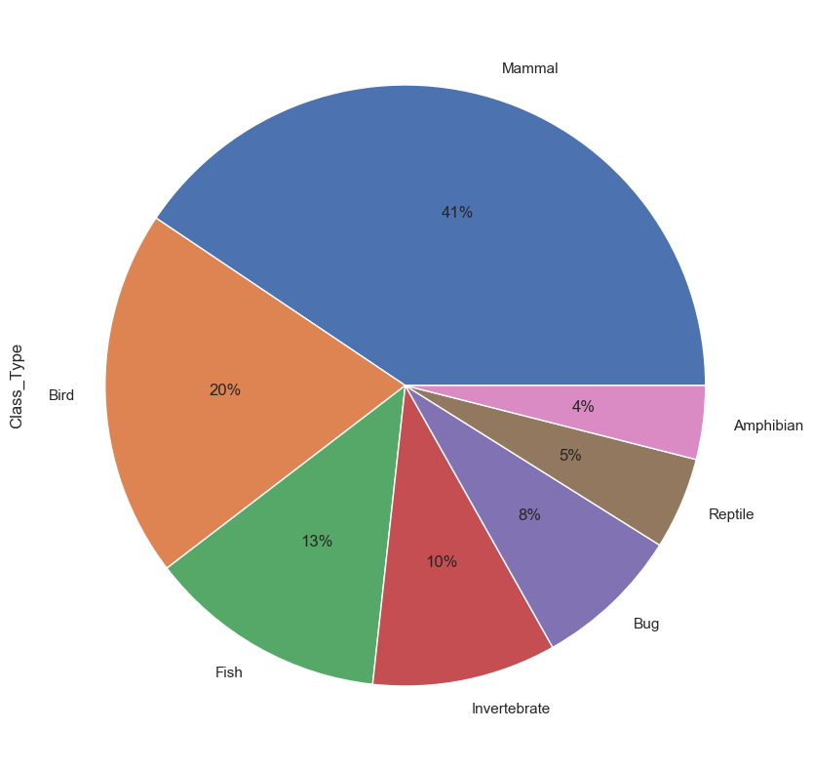
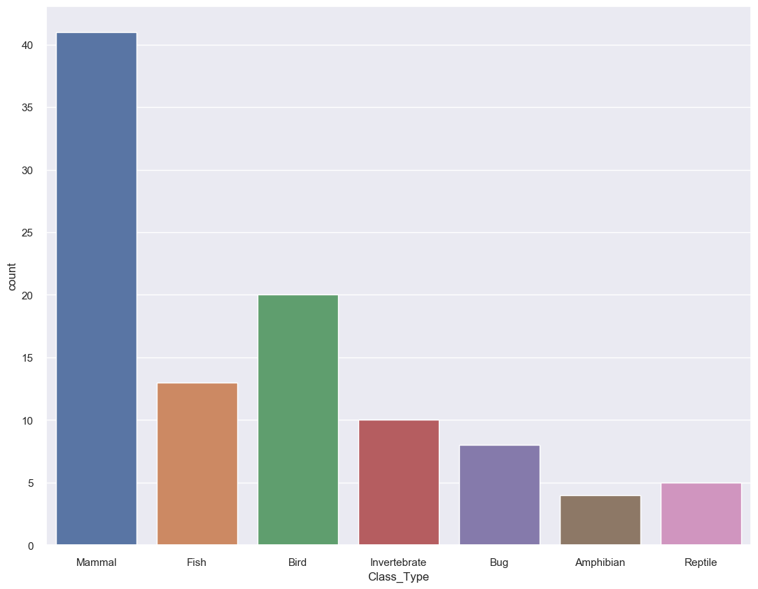
FINDINGS

Slide 8
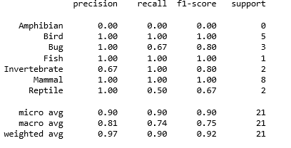
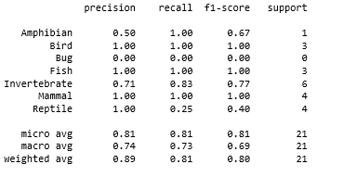
FINDINGS
Accuracy of Classification Prediction Models for the animals
Decision Tree Classifier
0.9047 (90.47%)
Random Forest Classifier
0.9523 (95.23%)
Summary: Random Forest Classifier has the best accuracy level
Classification Report

Slide 9
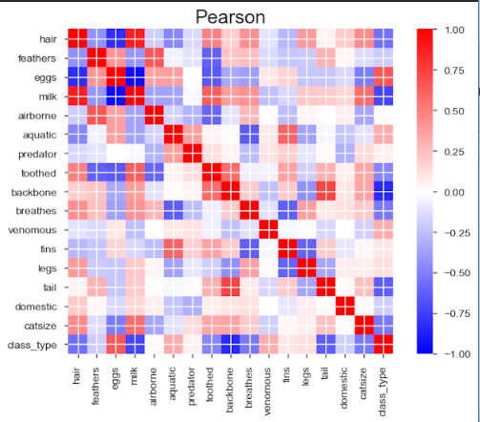
FINDINGS
Correlations

Slide 10
Challenges and limitations
Current data only shows one-time assessment, does not show trends of animal numbers.
Panel data (available from time-series data) would have shown trends over time and helped with predictions for future for Zoo populations.
Data did not show quantities of specific type of animals, hence prediction of future quantities of animals was difficult to predict
More data and further exercise required to predict actual class and animal name/type that can be introduced in the Zoo, and positively support or sustain the Zoo ecosystem, e.g.
Does the current population of various animals in a Zoo determine the future population and type/spread ?
What the next animal introduced or born in the Zoo will be ?

Slide 11
Acknowledgements
Data Science lecturers
Data Science Class/Colleagues
Kaggle Data Sources

Slide 12
REFERENCES
Zoo Data Set - https://archive.ics.uci.edu/ml/datasets/zoo
Kaggle Data Set - https://www.kaggle.com/uciml/zoo-animal-classification

Slide 13
Thank You
4

